Slide 1
Login Process guide

Slide 2
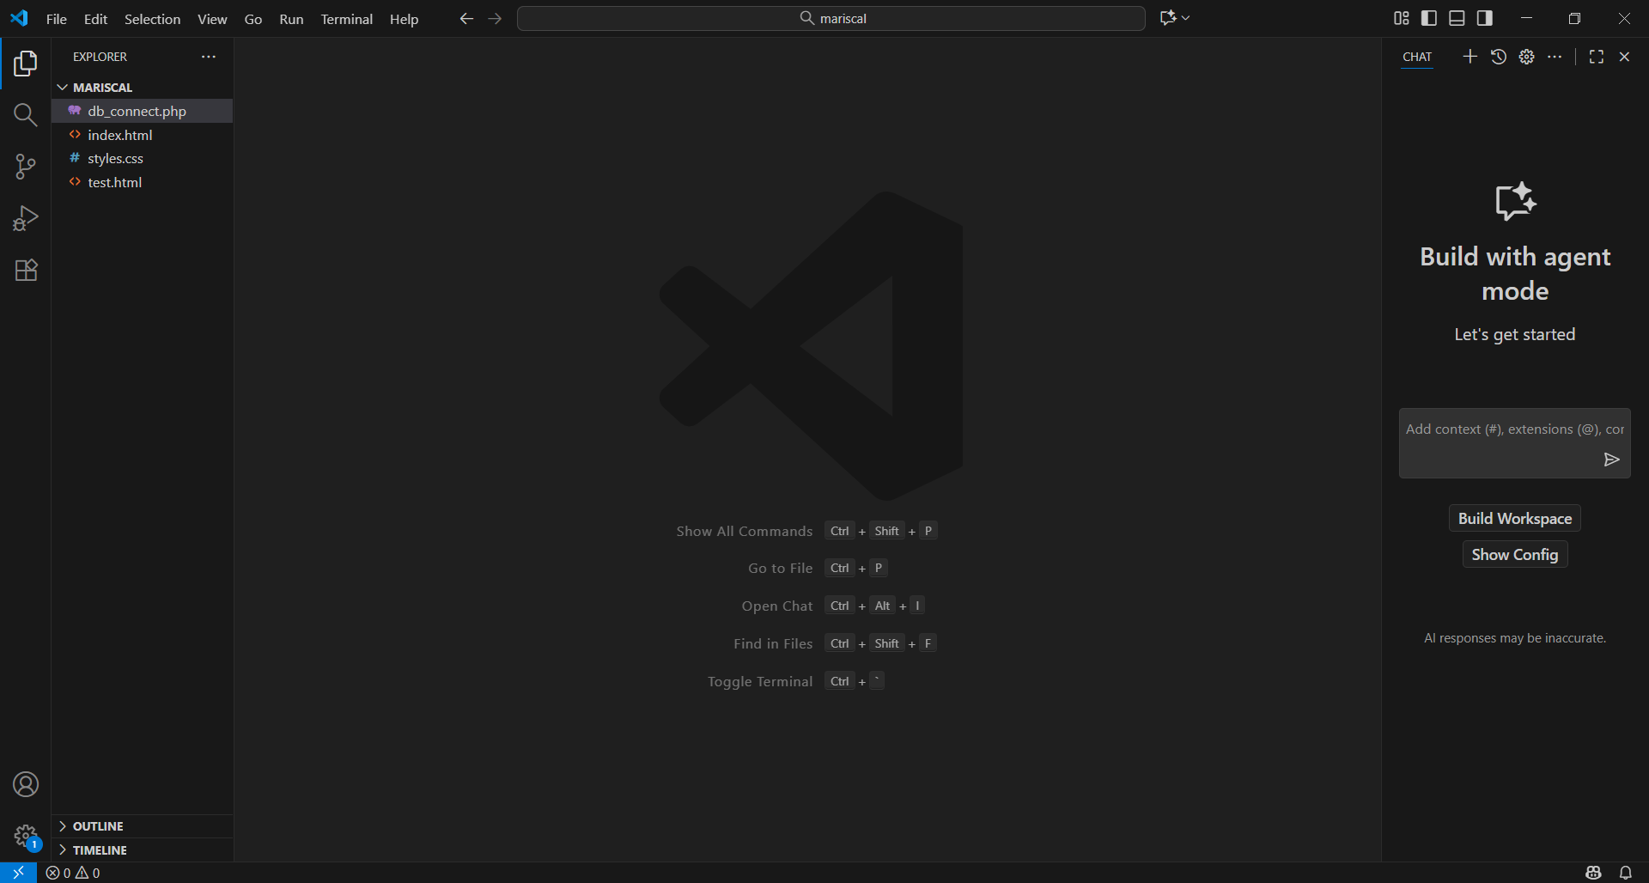
Instruction:
Open a text editor VISUAL STUDIO.

Slide 3
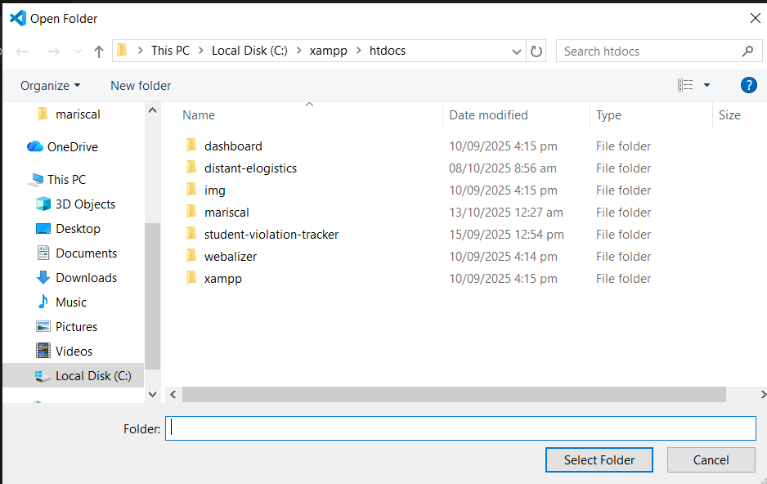
Instruction:
Create a folder inside xampp/htdocs and the folder to lastname
Step 1: Click the FILE upper right
Step 2: Find and click the Open Folder
Step 3: Locate Local Disk C: where xampp is located.
Step 4: Find xampp folder and open it.
Step 5: Inside xampp folder find htdocs.
Step 6: Inside htdocs RIGHT CLICK and find new folder or click the new folder above.
Step 7: After clicking the new folder rename it into your last name
Step 8: After renaming the folder click the SELECT FOLDER.

Slide 4
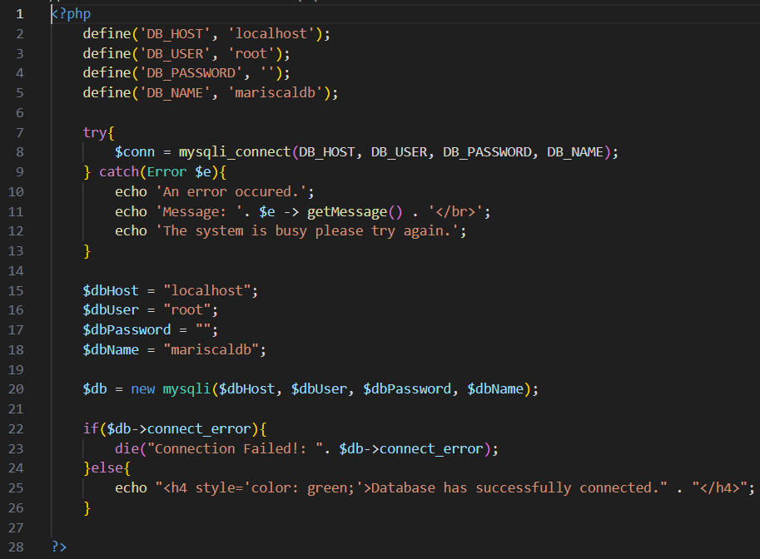

Instruction:
Create a FILE inside your folder and name it to db_connect.php
Step 1: Hover your mouse over your folder and you can find this icon click the first icon.
Step 2: After clicking the first icon then db_connect.php then press ENTER.
Step 3: After creating a file named db_connect.php type this following code.

Slide 5
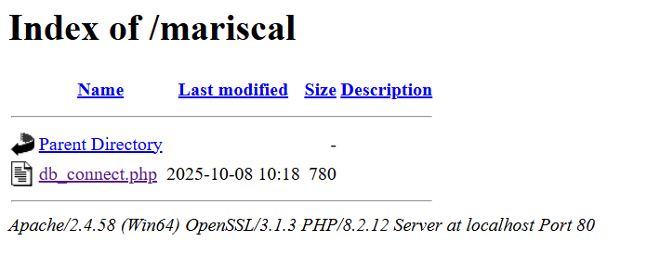

Instruction:
When you are finish typing the code we will check if the code is don’t have an error.
Step 1: Open your xampp control and start APACHE and MySQL
Step 2: Open a browser and type this following: localhost/phpmyadmin/ then click SQL button.
Step 3: Type this following SQL commands:
CREATE DATABASE [your lastname];
USE [your lastname];
CREATE TABLE tbluser(
user_id INT PRIMARY KEY AUTO_INCREMENT,
full_name VARCHAR(100) NOT NULL,
user_password VARCHAR(100) NOT NULL,
created_at TIMESTAMP DEFAULT CURRENT_TIMESTAMP
);
Step 4: After creating a database open a new browser and type this following: localhost/[your lastname]/ then press ENTER.
Step 6: As you image shown click db_connect.php and check if there is an error. If there is no error this message will displayed.

Slide 6
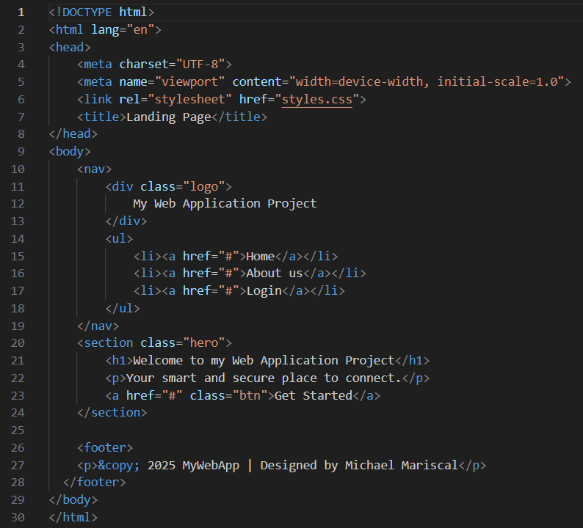
Instruction:
Create another file inside your folder and name it to index.html
Step 1: Same process from slide 4 and name it to index.html
Step 2: Type this following code inside index.html
Step 3: When you are finish type the code go back to the browser and type this following:
localhost/[your lastname]/

Slide 7
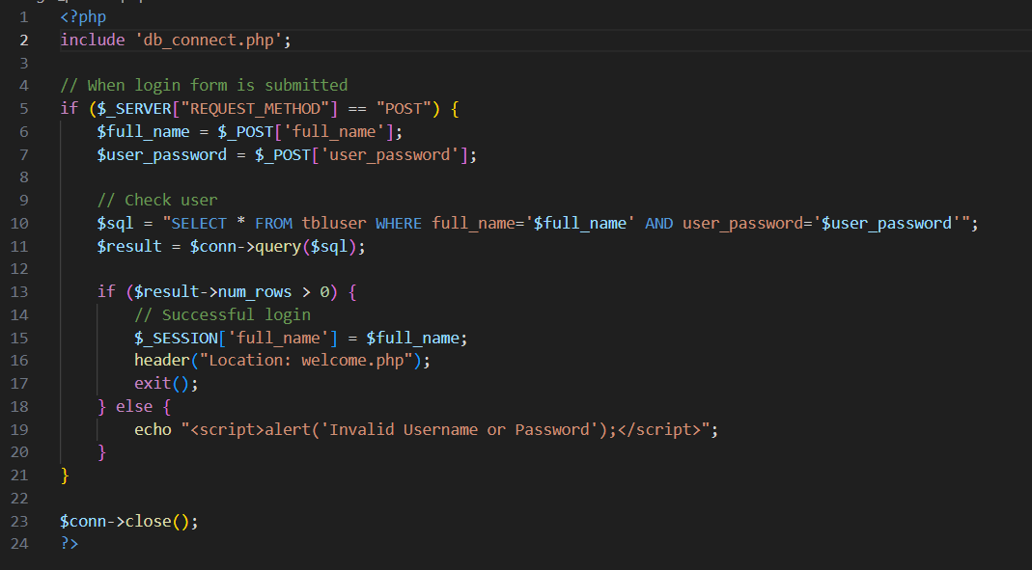
Instruction:
Create another php file and name it to login-process.php
Step 1: Same process from slide 4.
Step 2: After create a php file named login-process.php type the following code:

Slide 8
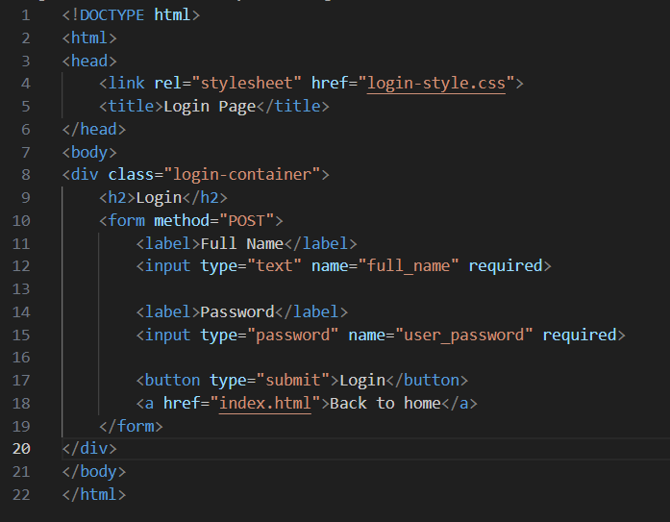
Instruction:
Create another html file and name it to login.html
Step 1: Same process from slide 4.
Step 2: After create a html file named login.html type the following code:

Slide 9
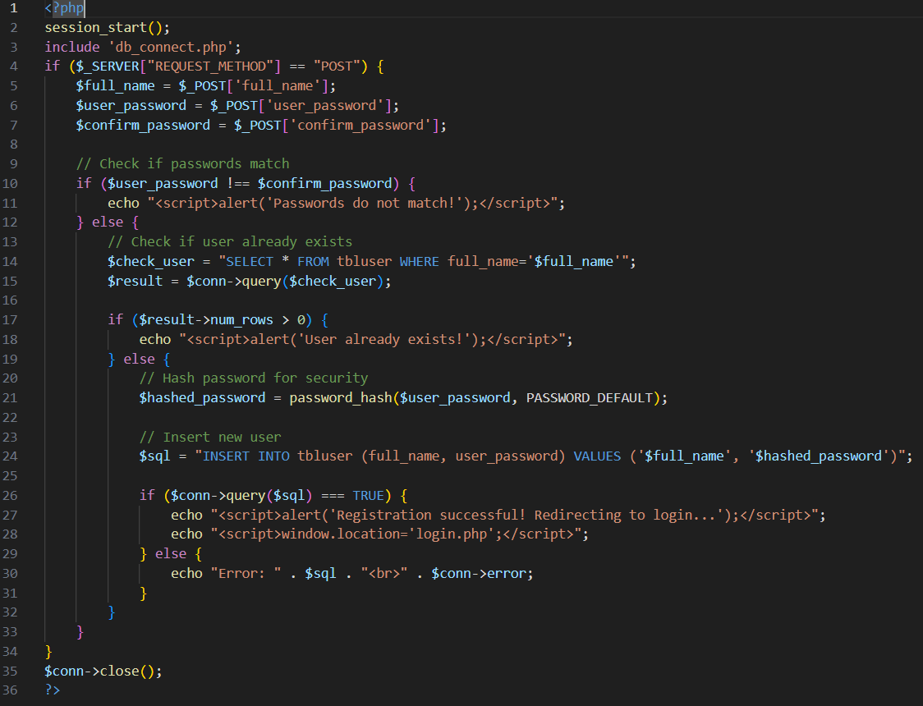
Instruction:
Create another php file and name it to registration-process.php
Step 1: Same process from slide 4.
Step 2: After create a php file named registration-process.php type the following code:

Slide 10
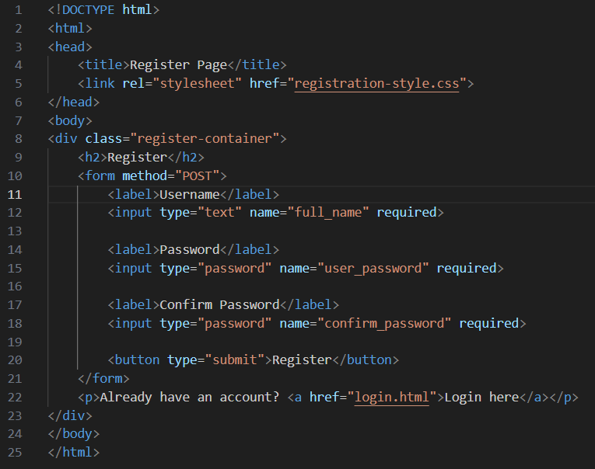
Instruction:
Create another html file and name it to register.html
Step 1: Same process from slide 4.
Step 2: After create a html file named register.html type the following code:

Slide 11
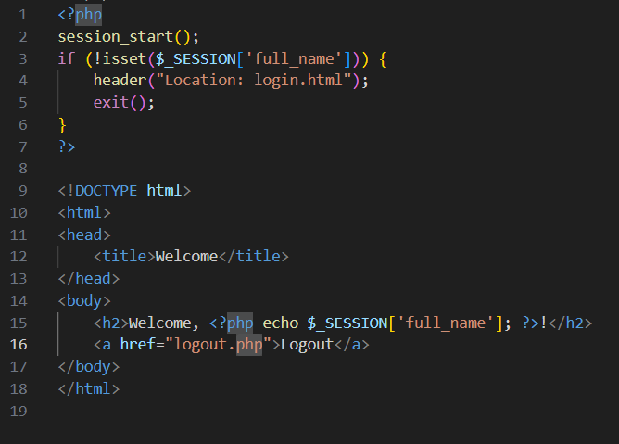
Instruction:
Create another php file and name it to welcome.php
Step 1: Same process from slide 4.
Step 2: After create a php file named welcome.php type the following code:

Slide 12
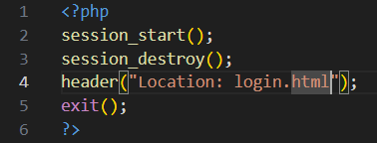
Instruction:
Create another php file and name it to logout.php
Step 1: Same process from slide 4.
Step 2: After create a php file named logout.php type the following code:

